Slide 1
Infosys Springboard Virtual Internship 6.0 Batch 11 Group-1
ElectViz – Election Data Visualization for Media
Transforming Indian Election Data into Actionable Insights Through Interactive Power BI Dashboards
Mentor: Mrs. Nithyasri S J
Presented by: Swayam Bana

Slide 2

Introduction
Indian elections produce large and complex datasets across constituencies.
Raw data alone cannot clearly explain party dominance or election competitiveness.
Deeper analysis is needed to understand regional trends and voter behavior over time.
ElectViz is a comprehensive Power BI–based analytics project designed to transform this raw election data into actionable insights through interactive dashboards.
The project analyzes seat performance, vote share distribution, demographic factors, candidate electability, historical trends, and winning factors.
Analysis is conducted across Indian elections from 2009 to 2021.

Slide 3
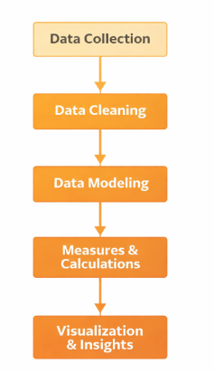
ARCHITECTURE
System Design & Workflow
01
02
Data Collection
Data Cleaning & Transformation
Historical Indian State Level Assembly Constituencies election datasets spanning 2009–2021, including candidate-level details, constituency demographics, from Kaggle
Power Query processes for removing duplicates, handling missing values, standardizing party names, and creating calculated columns for age groups, margins, and contest types
03
04
05
Data Modeling
Measures & Calculations
Visualization & Insights
Optimized star schema with relationships connecting Candidates, Constituencies, Parties, States, and Years for enhanced query performance
DAX formulas computing Winning Margin %, Close Contest Rate, Vote Share %, Repeat Candidate Rate, and Seats Won %
Interactive Power BI dashboards featuring dynamic slicers, drill-down capabilities, and cross-filtering for comprehensive analysis

Slide 4
Data Transformation Process
Power Query Operations
Data Quality Metrics
Automated duplicate removal across multiple data sources
Intelligent handling of missing values using contextual imputation
Standardization of party nomenclature across election years
Creation of derived attributes for enhanced analysis
The transformation process ensures data integrity through systematic validation and cleansing procedures, resulting in a unified dataset ready for comprehensive electoral analysis.
Key Achievement: Successfully standardized data from multiple sources spanning 12+ years of election history.
Calculated Dimensions
Age group categorization for demographic insights
Victory margin classifications
Contest type indicators (competitive vs. safe seats)

Slide 5
Key Insights Discovered
Vote Share Vs Seat Wins
Geographical Influence
Middle-Aged Dominance
Repeat Candidate Success
Direct vote share does not always translate into proportional seat victories, highlighting the impact of electoral system mechanics.
Geographical distribution of votes and constituency-level margins are critical determinants of election outcomes.
Middle-aged candidates consistently dominate seat victories, indicating a preference for seasoned leadership among voters.
Candidates who contest multiple elections demonstrate a significantly higher probability of winning, suggesting experience and recognition are key.
Increasing Competition
Elections across India are becoming increasingly competitive over time, with narrower victory margins in many constituencies.

Slide 6
MileStones Completed
• Election Overview dashboard creation
• Party Performance analysis
• Gender Distribution insights
• Visual selection & layout design
• Basic DAX measures implementation
• Slicers and filters integration
• KPI cards development
• Cross-visual interaction setup
• Candidate Demographics dashboard
• Electability analysis
• Custom DAX measures creation
• Advanced KPI calculations
• Margin & rate analysis
• Interactive filtering enhancement
• Data segmentation (age, category)
MileStone 1
MileStone 2
MileStone 3
MileStone 4
• Dataset understanding & exploration
• Data cleaning & preprocessing
• Missing & duplicate handling
• Data type correction
• Column standardization
• Initial data modeling (Power BI)
• Data validation checks
• Relationship creation between tables
• Basic KPI identification
• Trend Analysis implementation
• Winning Factor analysis
• Election Outcome insights
• Comparative performance study
• Final dashboard refinements
• Insight generation & validation
• Report documentation
• Project presentation

Slide 7
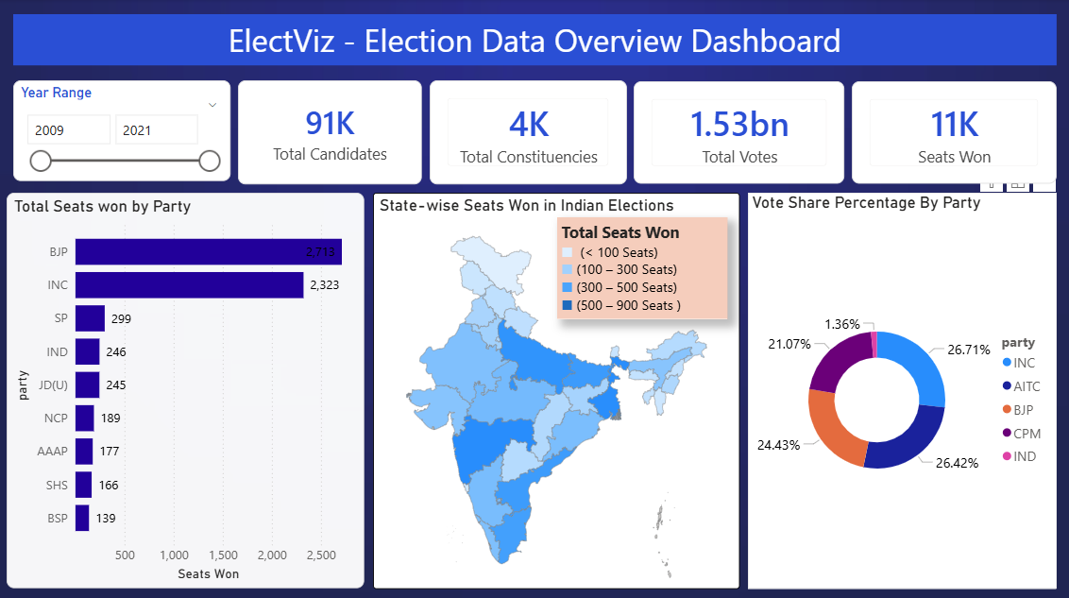
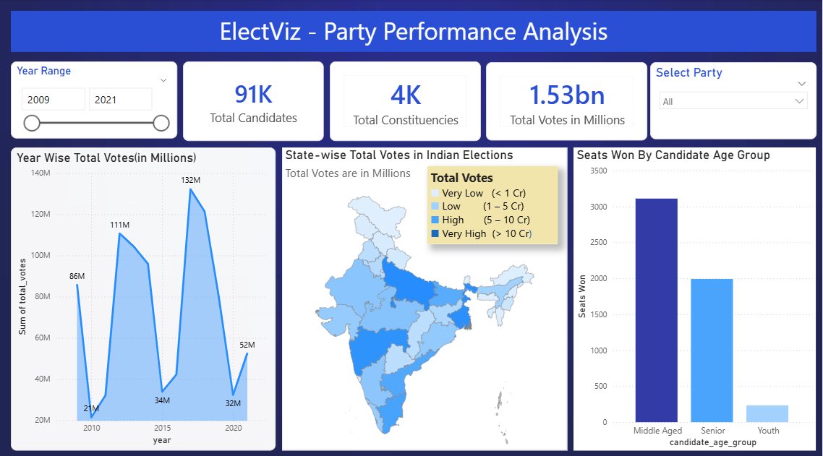
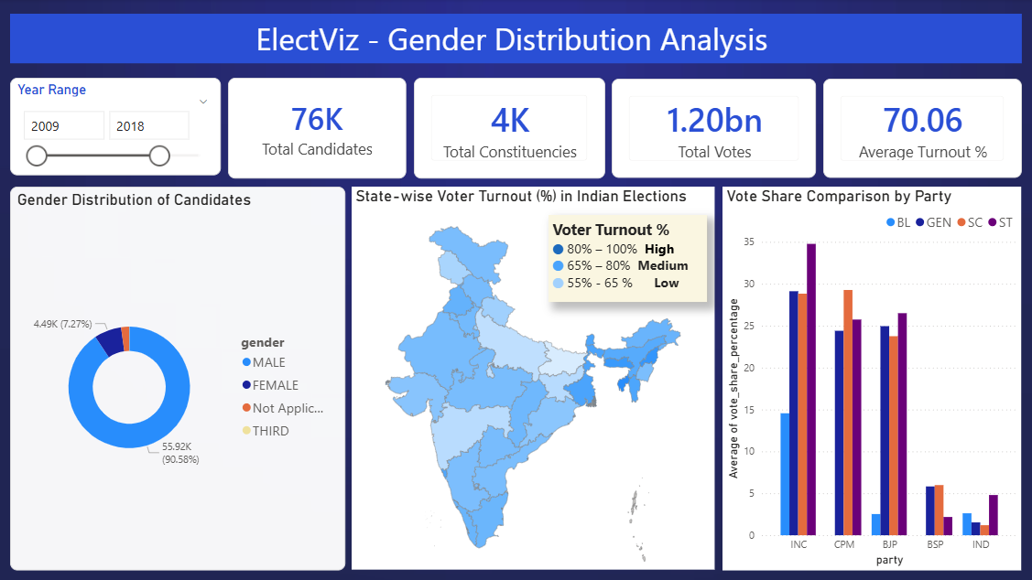
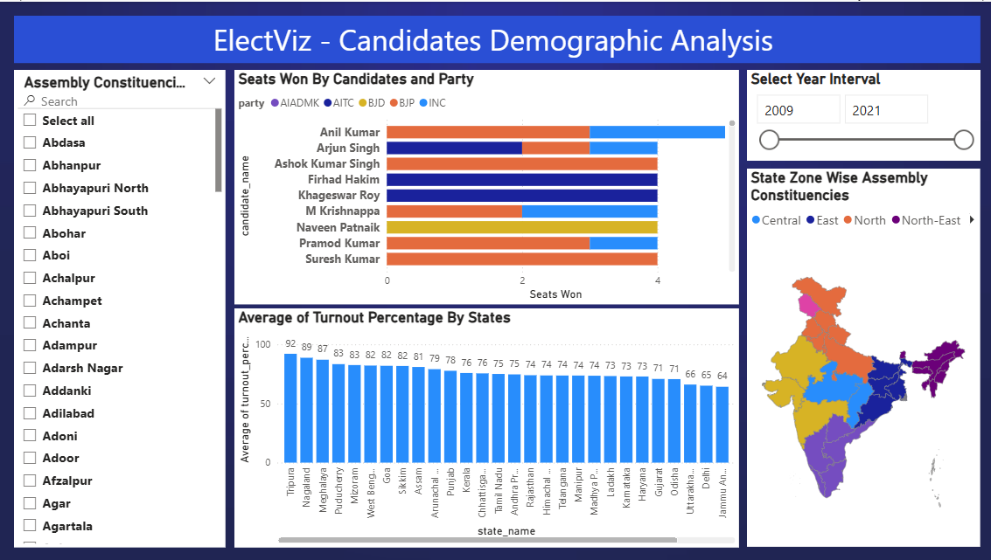
Dashboard Screenshots

Slide 8
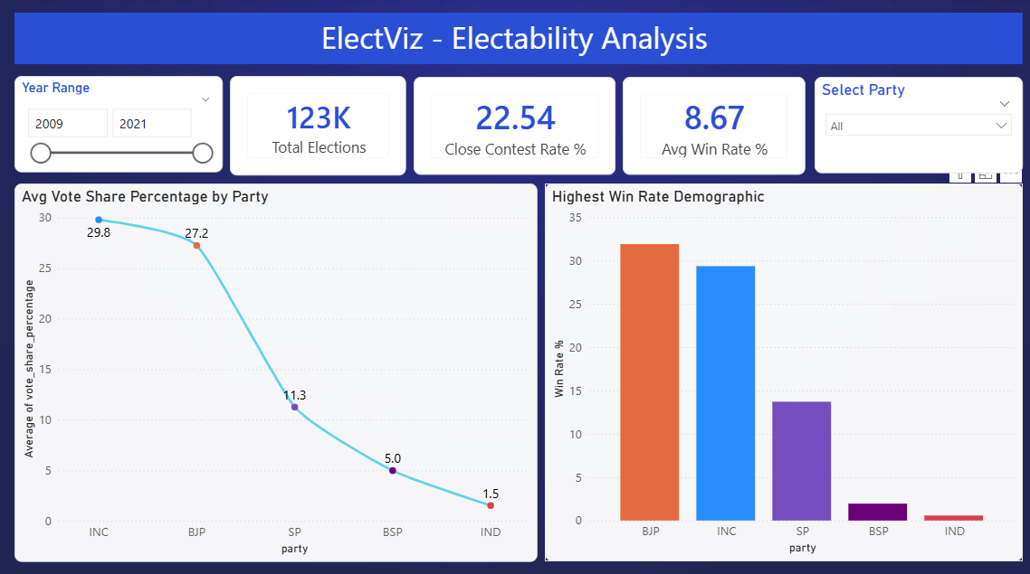
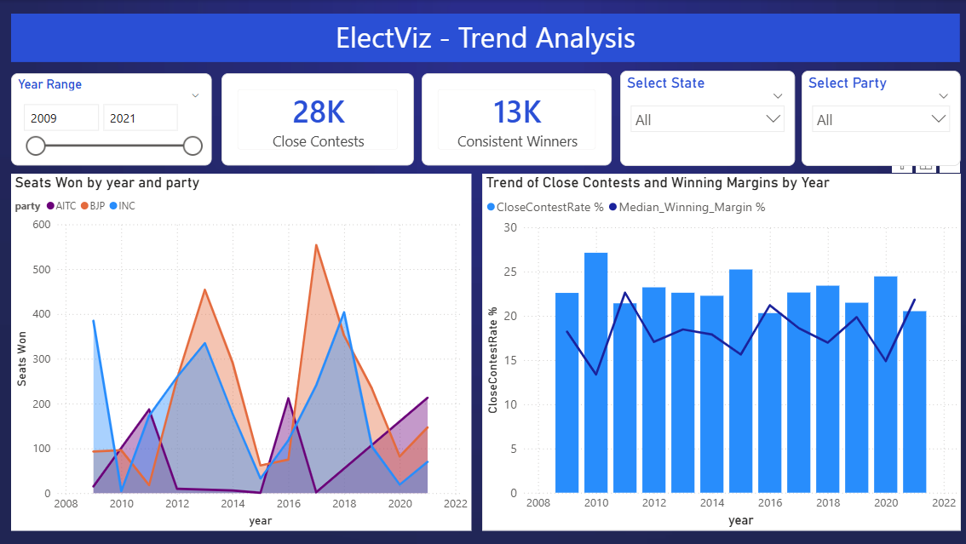
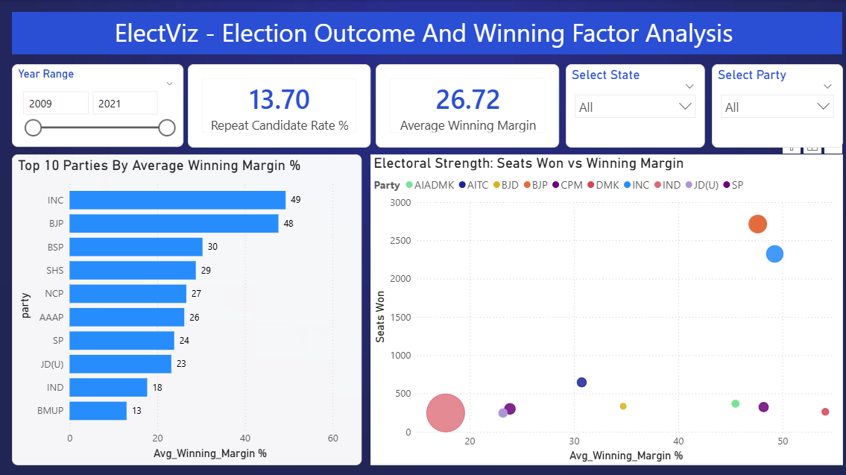
Dashboard Screenshots

Slide 9
Future Enhancements
1
2
3
4
Predictive Modeling
Enhanced Demographics
Real-Time Data Integration
Constituency Drill-Through
Machine learning algorithms for seat forecasting based on historical trends and current indicators
Integration of voter demographics including income levels, education, and rural-urban distribution patterns
Live election data APIs for up-to-the-minute results and trend analysis during active elections
Dedicated pages for deep-dive analysis of individual constituencies with historical comparisons
5
Sentiment Analysis
Natural language processing of news articles and social media to gauge public sentiment and predict electoral shifts

Slide 10
Acknowledgement & References
Acknowledgements
Infosys Springboard Team – for organizing this valuable internship opportunity
Our Mentor – for her continuous support and feedback
My Teammates – for collaboration, encouragement, and insights
This internship has been a significant step in our professional growth and technical journey.
References
Election Dataset (Kaggle source)
Microsoft Power BI Documentation
Infosys Springboard Virtual Internship course materials

Slide 11
Conclusion
This project demonstrates how election data can be transformed into actionable insights using data analytics and visualization.
By focusing on trends, competitiveness, and winning factors, the dashboards provide a deeper understanding of Indian electoral dynamics beyond traditional seat-based analysis.
Project Impact
ElectViz bridges the gap between raw electoral data and meaningful insights, enabling media professionals to deliver comprehensive, data-backed election coverage to the public.
Key Takeaways
1
Data-Driven Decision Making
2
Analytical Thinking in Political Analysis
3
Visualization as a Storytelling Tool
Empowering journalists and analysts with evidence-based insights for accurate election coverage
Moving beyond surface-level metrics to understand underlying electoral patterns
Transforming complex datasets into compelling narratives accessible to diverse audiences

Slide 12
Thank You
Thank you for your time and guidance throughout this project journey.
Questions & Discussion Welcome
I'm happy to discuss any aspect of the ElectViz project, from technical implementation details to potential applications in media coverage and political analysis.

